Slide 1
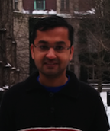
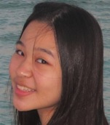
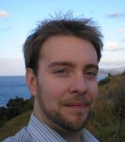
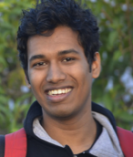
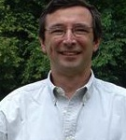
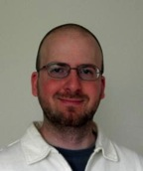
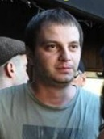
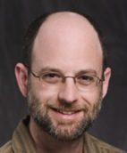
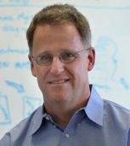

Swift Parallel Scripting for High-Performance Workflow
April 16, 2015
Michael Wilde wilde@anl.gov Daniel S. Katz dsk@uchicago.edu
http://swift-lang.org

Slide 2
Increasing capabilities in computational science
“Complexity”
Dimensions
Time
Resolution
Coupled (& non-linear) Equations
Components
Ensemble Members
Error Analysis
Optimization
Algorithms
1 2 3
Few Many
Short Long Multiscale
Coarse Fine Adaptive
Simple Complex
1 Many
1 Many
No Yes
No Yes
Domain of Interest
“Time”

Slide 3
Workflow needs
Application Drivers
Applications that are many-task in nature: parameters sweeps, UQ, inverse modeling, and data-driven applications
Analysis of capability application outputs
Analysis of stored or collected data
Increase productivity at major experiment facilities (light source, etc.)
Urgent computing
These applications are all many-task in nature
Requirements
Usability and ease of workflow expression
Ability to leverage complex architecture of HPC and HTC systems (fabric, scheduler, hybrid node and programming models), individually and collectively
Ability to integrate high-performance data services and volumes
Make use of the system task rate capabilities from clusters to extreme-scale systems
Approach
A programming model for programming in the large

Slide 4
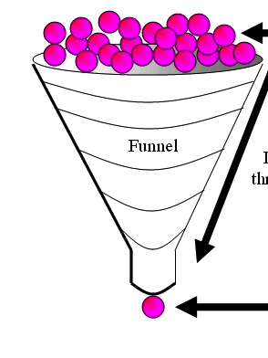
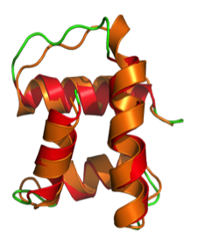
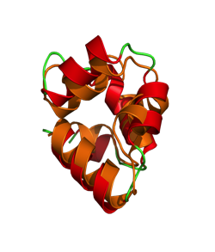
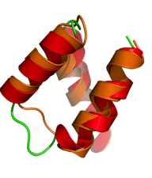
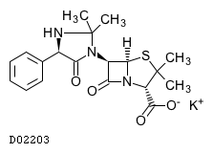
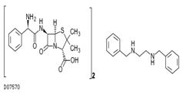
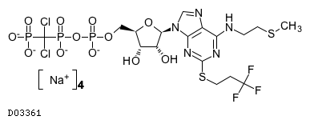
When do you need HPC workflow? Example application: protein-ligand docking for drug screening
O(100K)
drug
candidates
O(10) proteins implicated in a disease
X
…
= 1M
docking
tasks…
…then hundreds of detailed MD models to find
10-20 fruitful
candidates for wetlab & APS crystallography
(B)
Notes:
"docking" is the identification of the low-energy binding modes of a small molecule (ligands) within the active site of a macromolecule (receptor) whose structure is known
A compound that interacts strongly with (i.e. binds) a receptor associated with a disease may inhibit its function and thus act as a drug
Typical Workload:
Application Size: 7MB (static binary)
Static input data: 35MB (binary and ASCII text)
Dynamic input data:10KB (ASCII text)
Output data: 10KB (ASCII text)
Expected execution time: 5~5000 seconds
Parameter space: 1 billion tasks

Slide 5
Expressing this many task workflow in Swift
For protein docking workflow:
foreach p, i in proteins {
foreach c, j in ligands {
(structure[i,j], log[i,j]) =
dock(p, c, minRad, maxRad);
}
scatter_plot = analyze(structure)
To run:
swift –site tukey,blues dock.swift

Slide 6
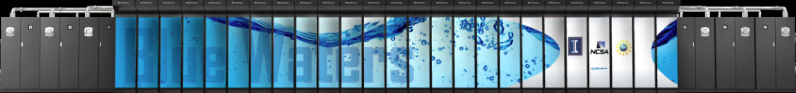




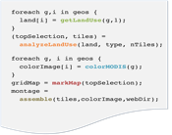



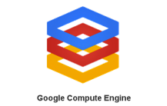


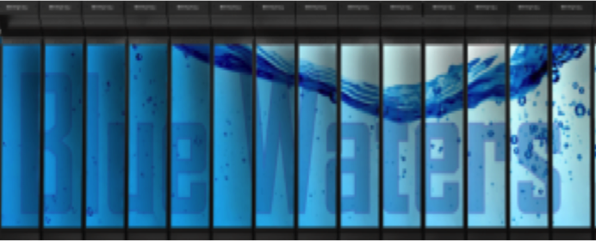
Swift enables execution of simulation campaigns across multiple HPC and cloud resources
Data servers
Data servers
Data servers
Petascale systems
National infrastructure
Scripts
Campus systems
Local data
mark
Apps
Swift host: login node, laptop, …
Cloud resources
The Swift runtime system has drivers and algorithms to efficiently support and aggregate diverse runtime environments
analyze
colorize
analyze
assemble
colorize
analyze
mark
assemble
colorize
apps
analyze
mark
assemble
colorize
apps
analyze
mark
assemble
colorize
apps
mark
assemble
apps
mark
apps
Notes:
6
Swift is a Java ap – untar or module load,and run
Data can be on client or remote (GirdFTP, ) – soon Globus Online.
Overlaps staging and computing wherever possible
Main role is to efficiently run Swift tasks on allocated compute nodes, local and remote
Handles short tasks efficiently without re-scheduling
Runs on distributed infrastructure: Condor, GRAM, AWS
Also runs with few infrastructure dependencies
Can optionally perform data staging
Provisioning can be automatic or external (manually launched or externally scripted)
Dynamically grows and shrinks worker pools
Handles failures through retry and restart

Slide 7
Swift in a nutshell
Data types
string s = “hello world”;
int i = 4;
int A[];
Mapped data types
type image;
image file1<“snapshot.jpg”>;
Mapped functions
app (file o) myapp(file f, int i)
{ mysim "-s" i @f @o; }
Conventional expressions
if (x == 3) {
y = x+2;
s = @strcat(“y: ”, y);
}
Structured data
image A[]<array_mapper…>;
Loops
foreach f,i in A {
B[i] = convert(A[i]);
}
Data flow
analyze(B[0], B[1]);
analyze(B[2], B[3]);
Swift: A language for distributed parallel scripting, J. Parallel Computing, 2011
Notes:
app (file f) predict (Protein seq, Float t, Float dt)
{ psim "-s" @seq.fasta "-pdb" @p ; }

Slide 8
Pervasively parallel
Swift is a parallel scripting system for grids, clouds and clusters
F() and G() are computed in parallel
Can be Swift functions, or leaf tasks (executables or scripts in shell, python, R, Octave, MATLAB, ...)
r computed when they are done
This parallelism is automatic
Works recursively throughout the program’s call graph
(int r) myproc (int i)
{
int f = F(i);
int g = G(i);
r = f + g;
}

Slide 9
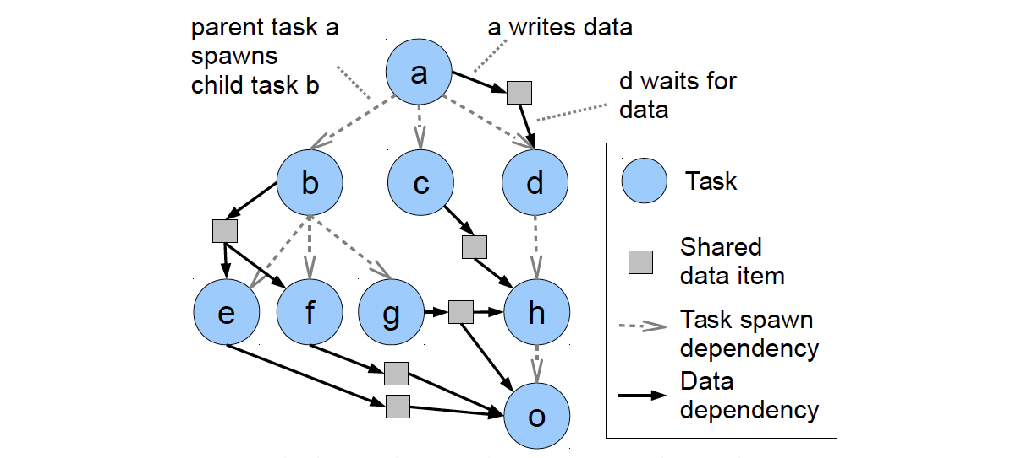
Pervasive parallel data flow

Slide 10
Data-intensive example: Processing MODIS land-use data
Image processing pipeline for land-use data from the MODIS satellite instrument…

Slide 11
Processing MODIS land-use data
foreach raw,i in rawFiles {
land[i] = landUse(raw,1);
colorFiles[i] = colorize(raw);
}
(topTiles, topFiles, topColors) =
analyze(land, landType, nSelect);
gridMap = mark(topTiles);
montage = assemble(topFiles,colorFiles,webDir);

Slide 12
Example of Swift’s implicit parallelism: Processing MODIS land-use data
Image processing pipeline for land-use data from the MODIS satellite instrument…
http://swift-lang.org

Slide 13
Swift provides 4 important benefits:
Makes parallelism more transparent
Implicitly parallel functional dataflow programming
Makes computing location more transparent
Runs your script on multiple distributed sites and diverse computing resources (desktop to petascale)
Makes basic failure recovery transparent
Retries/relocates failing tasks
Can restart failing runs from point of failure
Enables provenance capture
Tasks have recordable inputs and outputs

Slide 14



Swift/T: productive extreme-scale scripting
Swift worker process
Parallel evaluator and data store
Swift worker process
Swift control process
Swift worker process
Swift control process
MPI
Scripts
C
C++
Fortran
C
C++
Fortran
C
C++
Fortran
Script-like programming with “leaf” tasks
In-memory function calls in C++, Fortran, Python, R, … passing in-memory objects
More expressive than master-worker for “programming in the large”
Leaf tasks can be MPI programs, etc. Can be separate processes if OS permits.
Distributed, scalable runtime manages tasks, load balancing, data movement
User function calls to external code run on thousands of worker nodes
Notes:
Task data can be
in-memory objects
file stored on disk

Slide 15
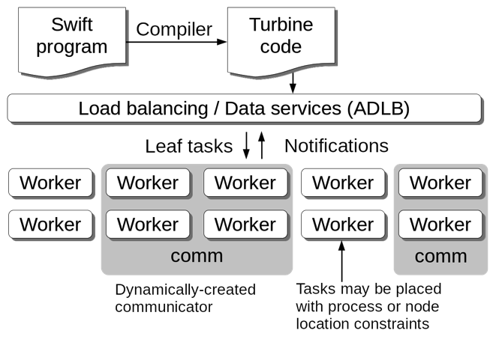
Parallel tasks in Swift/T
Swift expression: z = @par=32 f(x,y);
ADLB server finds 8 available workers
Workers receive ranks from ADLB server
Performs comm = MPI_Comm_create_group()
Workers perform f(x,y)communicating on comm
Notes:
Task data can be
in-memory objects stored in ADLB
file stored on disk, file vars in ADLB
Files can be stored in shared disk, or locally using MosaStore, Hercules, etc.

Slide 16
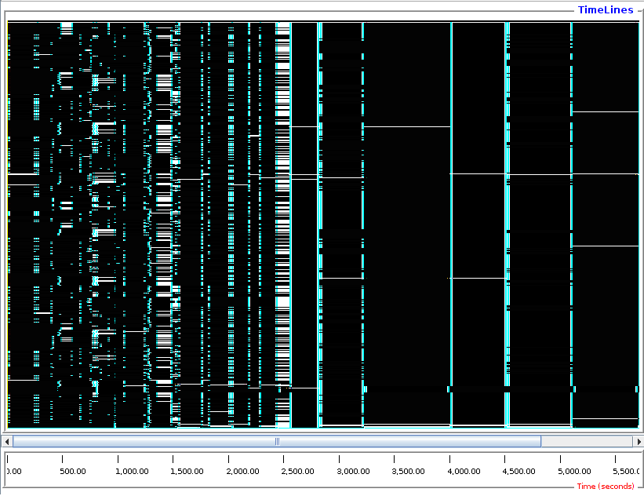
LAMMPS parallel tasks
foreach i in [0:20] {
t = 300+i;
sed_command = sprintf("s/_TEMPERATURE_/%i/g", t);
lammps_file_name = sprintf("input-%i.inp", t);
lammps_args = "-i " + lammps_file_name;
file lammps_input<lammps_file_name> =
sed(filter, sed_command) =>
@par=8 lammps(lammps_args);
}
LAMMPS provides a convenient C++ API
Easily used by Swift/T parallel tasks
Tasks with varying sizes packed into big MPI run Black: Compute Blue: Message White: Idle

Slide 17
Swift/T-specific features
Task locality: Ability to send a task to a process
Allows for big data –type applications
Allows for stateful objects to remain resident in the workflow
location L = find_data(D); int y = @location=L f(D, x);
Data broadcast
Task priorities: Ability to set task priority
Useful for tweaking load balancing
Updateable variables
Allow data to be modified after its initial write
Consumer tasks may receive original or updated values when they emerge from the work queue
Wozniak et al. Language features for scalable distributed-memory dataflow computing. Proc. Dataflow Execution Models at PACT, 2014.

Slide 18
Swift/T: scaling of trivial foreach { } loop 100 microsecond to 10 millisecond tasks on up to 512K integer cores of Blue Waters

Slide 19
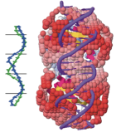
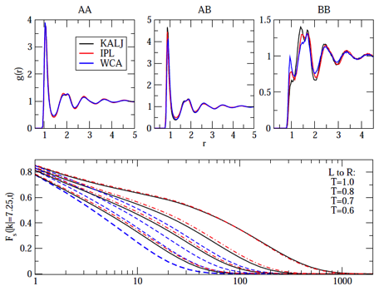
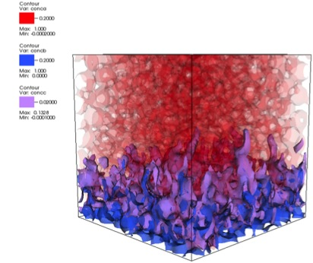
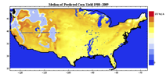
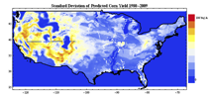
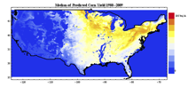
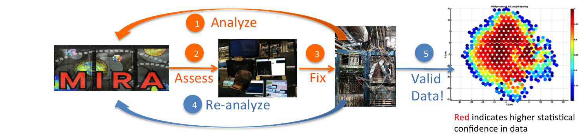
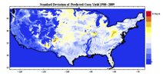
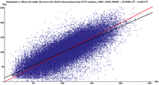
Large-scale applications using Swift
Simulation of super- cooled glass materials
Protein and biomolecule structure and interaction
Climate model analysis and decision making for global food production & supply
Materials science at the Advanced Photon Source
Multiscale subsurface flow modeling
Modeling of power grid for OE applications
All have published science results obtained using Swift
A
B
A
C
B
D
E
F
E
F
D
C

Slide 20
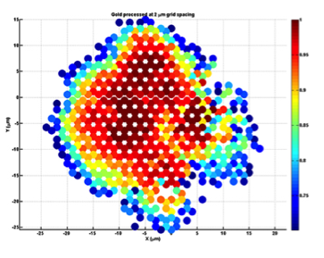
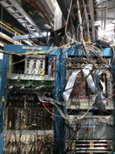

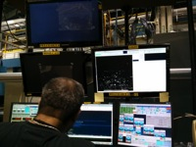
Boosting Light Source Productivity with Swift ALCF Data Analysis H Sharma, J Almer (APS); J Wozniak, M Wilde, I Foster (MCS)
Impact and Approach | Accomplishments | ALCF Contributions
HEDM imaging and analysis shows granular material structure, of non-destructively APS Sector 1 scientists use Mira to process data from live HEDM experiments, providing real-time feedback to correct or improve in-progress experiments Scientists working with Discovery Engines LDRD developed new Swift analysis workflows to process APS data from Sectors 1, 6, and 11 | Mira analyzes experiment in 10 mins vs. 5.2 hours on APS cluster: > 30X improvement Scaling up to ~ 128K cores (driven by data features) Cable flaw was found and fixed at start of experiment, saving an entire multi-day experiment and valuable user time and APS beam time. In press: High-Energy Synchrotron X-ray Techniques for Studying Irradiated Materials, J-S Park et al, J. Mat. Res. Big data staging with MPI-IO for interactive X-ray science, J Wozniak et al, Big Data Conference, Dec 2014 | Design, develop, support, and trial user engagement to make Swift workflow solution on ALCF systems a reliable, secure and supported production service Creation and support of the Petrel data server Reserved resources on Mira for APS HEDM experiment at Sector 1-ID beamline (8/10/2014 and future sessions in APS 2015 Run 1)
1
Analyze
2
3
5
Assess
Fix
Valid Data!
4
Re-analyze
Red indicates higher statistical confidence in data
Notes:
Impact and Approach
HEDM = High Energy Diffraction Microscopy
Accomplishments
Developed new analysis technique using Swift to process data from the APS at Sectors 1, 6 and 11 (in collaboration with APS and DEBD Grand Challenge LDRD)
The “boosting” success story is about HEDM at Sector 1. Mira was also used for diffuse scattering analysis and simulation at Sectors 6 & 11.
ALCF Contributions
Design, development, support and trial user engagement to make workflow solutions on ALCF systems a reliable, secure and supported production service
The support of Justin’s effort to develop and improve Swift execution on Mira, and to help code and test the scripts to run the NF-HEDM science code.
The support of Ketan’s effort to design and implement a flexible production workflow service
Creation and support of the Petrel data server
Petrel was not used in this specific accomplishment, but is expected to be useful to APS scientists in the future.
Reservation on Mira (8 racks) for APS HEDM experiment at Sector 1-ID beamline (8/10/2014)
We are gathering data on specifics. I think the Mira project used ws “DEBD” or “Discovery Engines”
Publications
"High-Energy Synchrotron X-ray Techniques for Studying Irradiated Materials", J.-S. Park et al, J.Mat. Res. (in press) describes the new HEDM code that was developed and used here. Swift in turn was used to create the workflow to run this code on all the data from an experiment.
Big data staging with MPI-IO for interactive X-ray science
Justin M. Wozniak, Hemant Sharma, Timothy G. Armstrong, Michael Wilde, Jonathan D. Almer, Ian T. Foster
Proc. IEEE/ACM Symposium on Big Data Computing, 2014.
DEBD DGC is Argonne Directors Grand Challenge LDRD “Integrating Simulation and Observation: Discovery Engines for Big Data”)
The data plots are “confidence plots”. Redder is better.

Slide 21
Conclusion: parallel workflow scripting is practical, productive, and necessary, at a broad range of scales
Swift programming model demonstrated feasible and scalable on XSEDE, Blue Waters, OSG, DOE systems
Applied to numerous MTC and HPC application domains
attractive for data-intensive applications
and several hybrid programming models
Proven productivity enhancement in materials, genomics, biochem, earth systems science, …
Deep integration of workflow in progress at XSEDE, ALCF
Workflow through implicitly parallel dataflow is productive for applications and systems at many scales, including on highest-end system

Slide 22
What’s next?
Programmability
New patterns ala Van Der Aalst et al (workflowpatterns.org)
Fine grained dataflow – programming in the smaller?
Run leaf tasks on accelerators (CUDA GPUs, Intel Phi)
How low/fast can we drive this model?
PowerFlow
Applies dataflow semantics to manage and reduce energy usage
Extreme-scale reliability
Embed Swift semantics in Python, R, Java, shell, make
Can we make Swift “invisible”? Should we?
Swift-Reduce
Learning from map-reduce
Integration with map-reduce

Slide 23
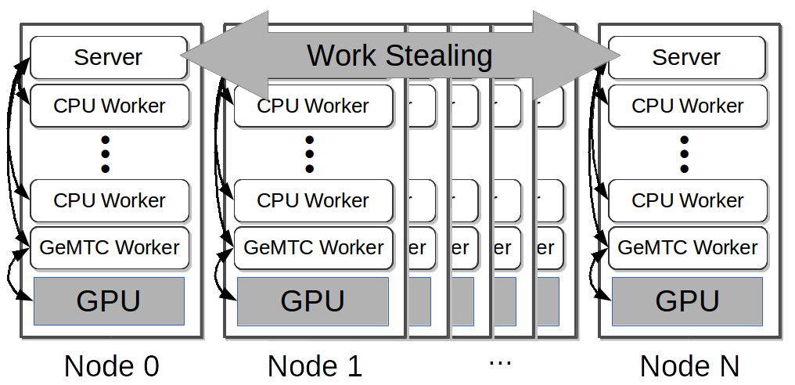
GeMTC: GPU-enabled Many-Task Computing
Motivation: Support for MTC on all accelerators!
Goals:
1) MTC support 2) Programmability
3) Efficiency 4) MPMD on SIMD
5) Increase concurrency to warp level
Approach:
Design & implement GeMTC middleware:
1) Manages GPU 2) Spread host/device
3) Workflow system integration (Swift/T)
S. J. Krieder, J. M. Wozniak, T. Armstrong, M. Wilde, D. S. Katz, B. Grimmer, I. T. Foster, I. Raicu, "Design and Evaluation of the GeMTC Framework for GPU-enabled Many-Task Computing,” HPDC'14

Slide 24
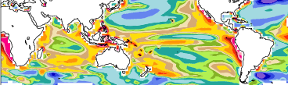
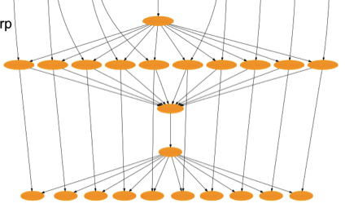
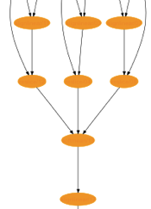
Further research directions
Deeply in-situ processing for extreme-scale analytics
Shell-like Read-Evaluate-Print Loop ala iPython
Debugging of extreme-scale workflows
Deeply in-situ analytics of a climate simulation
Notes:
Deeply in-situ procesisng
Potential new model for extreme-scale analytics
Multiple workflows (and even users) could share resources to analyze a running model
Minimize data movement volume and distance
Work in progress by GLEAN, DIY, ADIOS, Dataspaces

Slide 25




Swift gratefully acknowledges support from:
U.S. DEPARTMENT OF
ENERGY
http://swift-lang.org
Notes:
Talk about the Globus as being part of UChicago + ANL, as well as other context setting about how this work came about and is funded

